Slide 1
Virtual Entities
Module 9
Notes:
Virtual entities replace previous client-side and server-side approaches to integrating external data, which required customized code and suffered from numerous limitations, including imperfect integration, data duplication, or extensive commitment of development resources. In addition, for administrators and system customizers, the use of virtual entities greatly simplifies administration and configuration

Slide 2
Objectives
Introduction to virtual entities
Limitations of Virtual Entities
Virtual Entity Data Providers
Virtual entity creation

Slide 3
Introduction to Virtual entities
Integration with external data
Reduce data duplication
Data retrieved dynamically from external system
Entity data providers used to retrieve data from external data source
Notes:
Starting with the Dynamics 365 (online), version 9.0, virtual entities enable the integration of data residing in external systems by seamlessly representing that data as entities in Dynamics 365, without replication of data and often without custom coding. The initial implementation of this feature provides just read-only support for such entities, and has a number of other limitations.

Slide 4
Limitations of Virtual Entities
Data is Read Only
Only Organization owned entities are supported
All external entities must have a GUID primary key
Entity properties must be represented as Dynamics 365 attributes
An entity attribute cannot be calculated or rollup
Auditing and change tracking not supported
Cannot enable virtual entities for queues
All entity properties must be represented as Dynamics 365 attributes
Notes:
In this release, there are some limitations to virtual entities that you need to be aware of when evaluating whether you can use virtual entities with your external data.
Data is read-only. The virtual entity feature doesn’t support pushing changes made in Dynamics 365 back to the external system.
Only organization-owned entities are supported. The security filtering applied to user-owned entities is not supported. Access to the virtual entity data can be turned on or off for individual users based on their security role. Field-level security is not supported.
It must be possible to model the external data as a Dynamics 365 entity. This means:
All entities in the external data source must have an associated GUID primary key.
All entity properties must be represented as Dynamics 365 attributes. You can use simple types representing text, numbers, optionsets, dates, images, and lookups.
You must be able to model any entity relationships in Dynamics 365.
An attribute on a virtual entity cannot be calculated or rollup. Any desired calculations must be done on the external side, possibly within or directed by the data provider.

Slide 5
Virtual Entity Data Providers
Implemented as plugins
Currently only supports read operations
Available providers
Odata v4 (installed by default)
Azure CosmosDB (available fro AppSource)
More to be released
Custom data providers can be developed (Custom Plugins)
Notes:
A virtual entity is a definition of an entity in the Dynamics 365 platform metadata without the associated physical tables for entity instances created in the Dynamics 365 database. Instead during runtime, when an entity instance is required, its state is dynamically retrieved from the associated external system. Each virtual entity type is associated with a virtual entity data provider and (optionally) some configuration information from an associated virtual entity data source.
A data provider is a particular type of Dynamics 365 plugin, which is registered against CRUD events that occur in the platform. This initial release only supports READ operations.
The following data providers ship with Dynamics 365 (online), version 9.0:
An OData v4 provider is included with the service and is installed by default.
An Azure Cosmos DB (formerly Microsoft Document DB) provider is available from AppSource.
Additional providers will be made available by Microsoft, its partners, or other third parties. If a data provider cannot be found for your external data source, you can develop a custom virtual entity data provider; for more information, see https://docs.microsoft.com/en-us/dynamics365/customer-engagement/developer/virtual-entities/custom-ve-data-providers

Slide 6
Categories of Data Providers
Generic
If the schema of the data source changes, the affected virtual entities must only be remapped
Targeted
If the schema of the data source changes, the data provider must be updated and rebuilt
Notes:
There are two general categories of data provider you can create using the virtual entity data SDK assemblies: generic or targeted. The following describes these approaches and matches them to the data provider development model best suited for that approach.
Generic
"Bare metal" provider
These providers can flexibly translate FetchXML query expressions to the associated request to the external data source, then return the resulting entity instances. Such a provider can be reused for all instances of this data source type. This approach is the most general but is more complicated to develop. If the schema of the data source changes, the affected virtual entities must only be remapped.
Targeted
LINQ provider for known schema
Such a provider only narrowly translates queries into the associated LINQ call to a known, existing data source instance. The data source must be a LINQ provider as described in the topic Enabling a Data Source for LINQ Querying. This approach is limited to a specific data source instance, but requires much less coding. If the schema of the data source changes, the data provider must be updated and rebuilt.

Slide 7
Virtual entity creation and mapping
Creation similar to standard entity
Additional configuration includes
Connect virtual entity to a data provider
Entity type and it’s fields must be ‘mapped’
ID of entity must be mapped to external data
Notes:
Initially, defining a virtual entity is the same as defining a custom entity: you specify the entity, attributes, and relationships for the new virtual entity type. However, additionally, you then connect the virtual entity to a data provider to manage data retrieval. The custom entity type and its fields must be mapped to the corresponding data in the external data source. For example, a virtual entity might be represented as a row in an external relational database, and each of its fields might correspond to a column in that row. (Note that these external data names are often different than their corresponding virtual entity names.) A specific, required mapping occurs for the entity ID field: the data provider must be able to provide this GUID and associate it to the external record that represents this entity instance. The most direct way to achieve this is to actually use GUIDs as primary keys in the external data source.
In this example, a corresponding virtual entity data source would also be provided to supply user and connection information for the external database

Slide 8
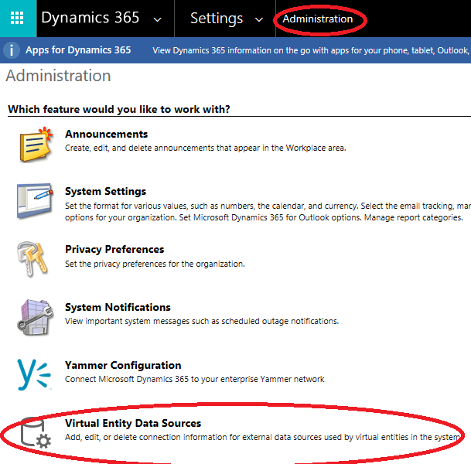
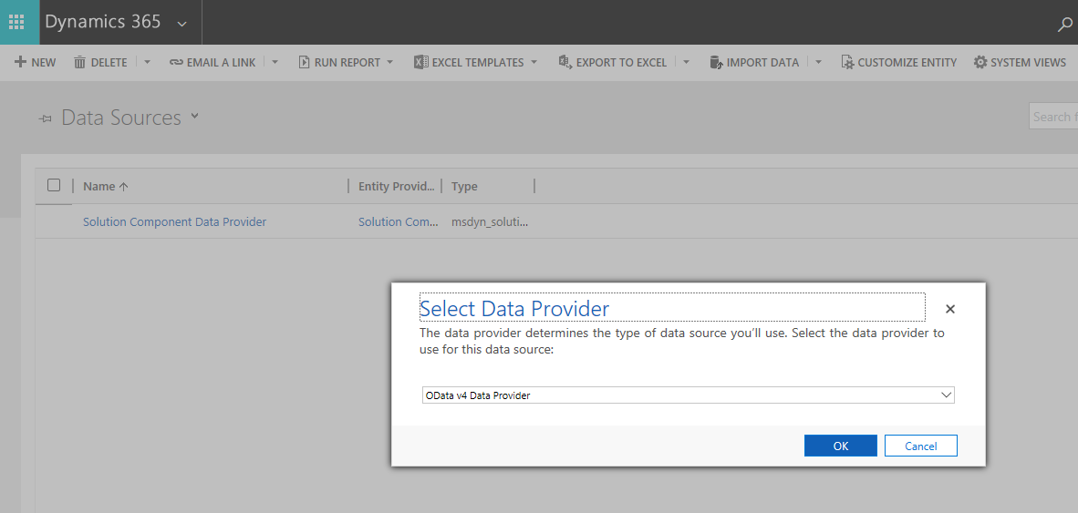
Create a Virtual Entity Data Source

Slide 9
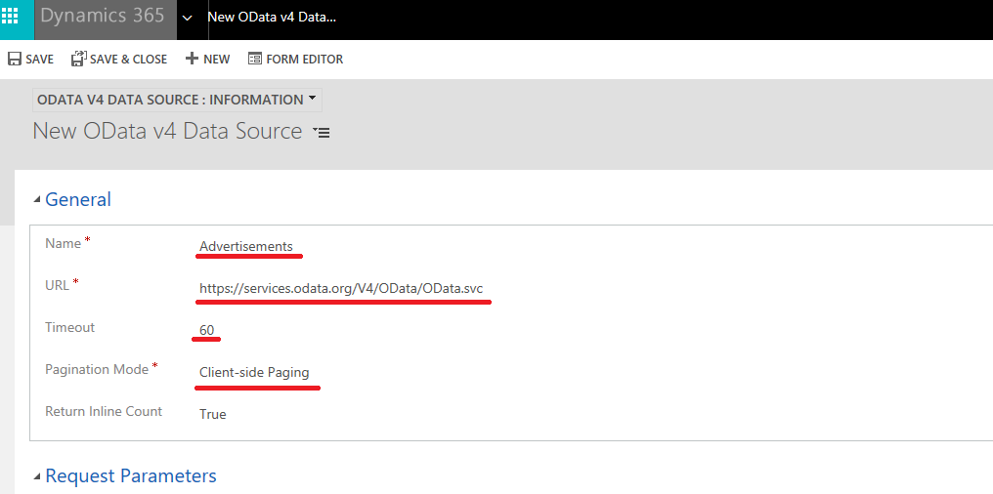
Create a Virtual Entity Data Source

Slide 10
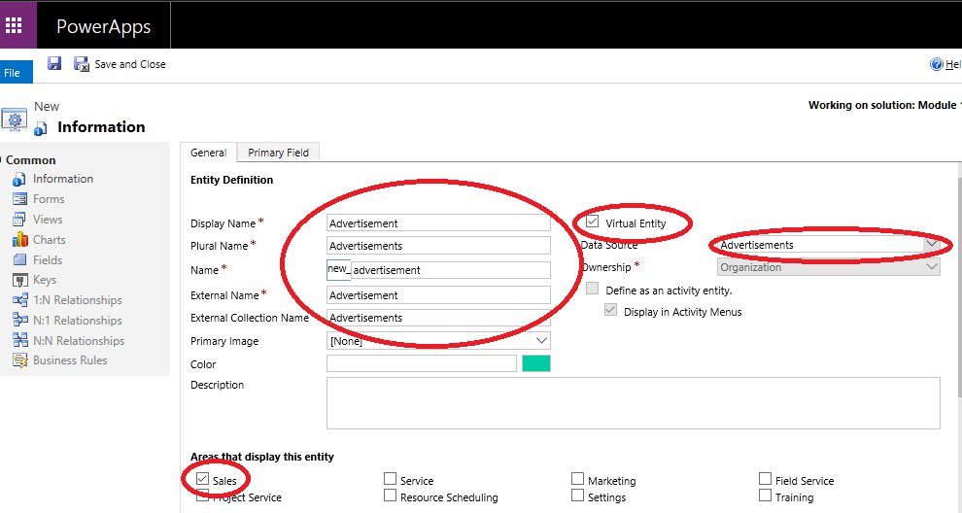
Create a Virtual Entity

Slide 11
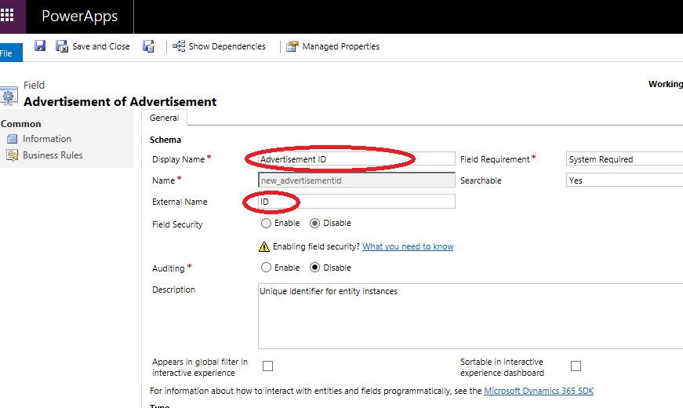
Mapping fields
Notes:
Name and ID fields for virtual entity are automatically created but mapping must be completed as shown in the slides

Slide 12
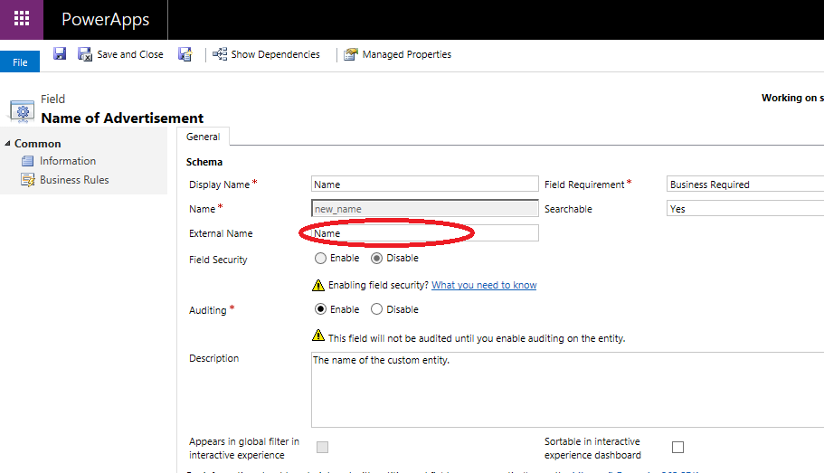
Mapping fields

Slide 13
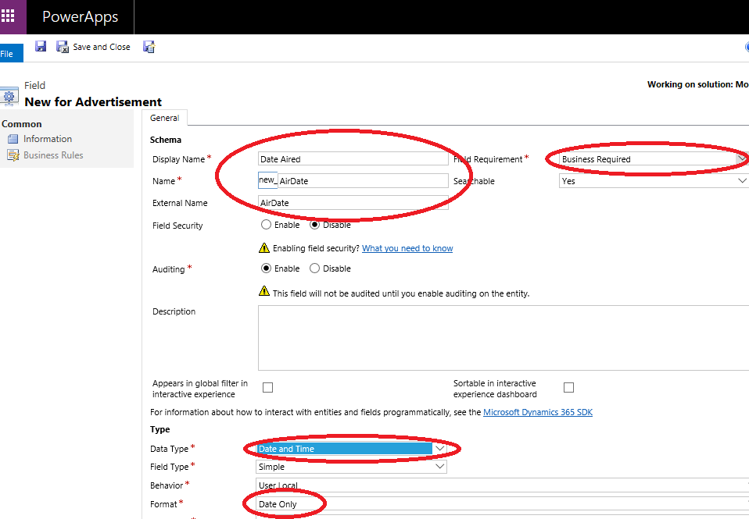
Mapping additional fields

Slide 14
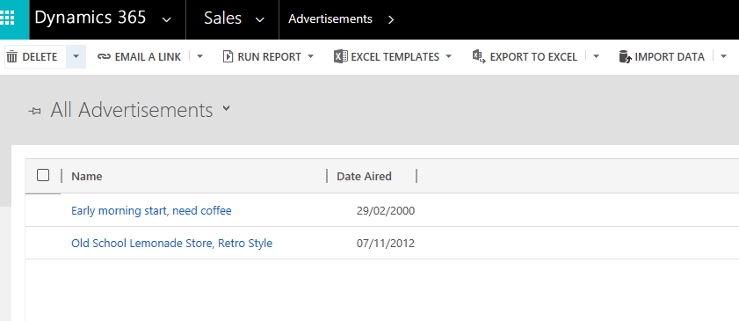
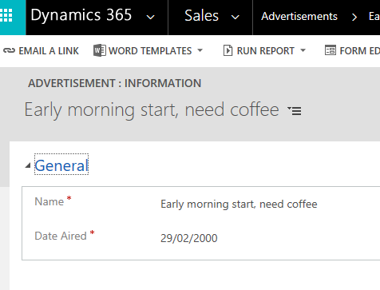
Create a forms and views as per standard Entity

Slide 15
Module 9 Lab A
Creating a virtual entity
Notes:
A virtual entity is a definition of an entity in the Dynamics 365 platform metadata without the associated physical tables for entity instances created in the Dynamics 365 database. Instead during runtime, when an entity instance is required, its state is dynamically retrieved from the associated external system. Each virtual entity type is associated with a virtual entity data provider and (optionally) some configuration information from an associated virtual entity data source.
A data provider is a particular type of Dynamics 365 plugin, which is registered against CRUD events that occur in the platform. This initial release only supports READ operations.
The following data providers ship with Dynamics 365 (online), version 9.0:
An OData v4 provider is included with the service and is installed by default.
An Azure Cosmos DB (formerly Microsoft Document DB) provider is available from AppSource.
Additional providers will be made available by Microsoft, its partners, or other third parties. If a data provider cannot be found for your external data source, you can develop a custom virtual entity data provider; for more information, see https://docs.microsoft.com/en-us/dynamics365/customer-engagement/developer/virtual-entities/custom-ve-data-providers

